Slide 1
Lead Scoring Case Study
Building predictive models for filtering out leads most likely to convert from data sets.
Presented By
Vatsal Gohel & Sai Charan

Slide 2
Problem Statement:
X Education sells online courses to industry professionals.
X Education gets a lot of leads but its lead conversion rate is very poor. For example, if they acquire 100 leads in a day, only about 30 of them are converted.
To make this process more efficient, the company wishes to identify the most potential leads, also known as ‘Hot Leads’.
If they successfully identify this set of leads, the lead conversion rate should go up as the sales team will now be focusing more on communicating with the potential leads rather than making calls to everyone.
Business Goal:
X education wants to know most promising leads.
For that they want to build a Model which identifies the hot leads.
Deployment of the model for the future use.
The CEO, in particular, has given a ballpark of the target lead conversion rate to be around 80%.

Slide 3
Solution Methodology:
Source the data for analysis
Clean and prepare the data
Exploratory Data Analysis (EDA)
Dummy Variables
Splitting the data into Test and Train dataset
Feature Scaling
Building a logistic Regression model
Evaluating the model by using different metrics - Specificity and Sensitivity or Precision and Recall
Applying the best model in Test data
Conclusions

Slide 4
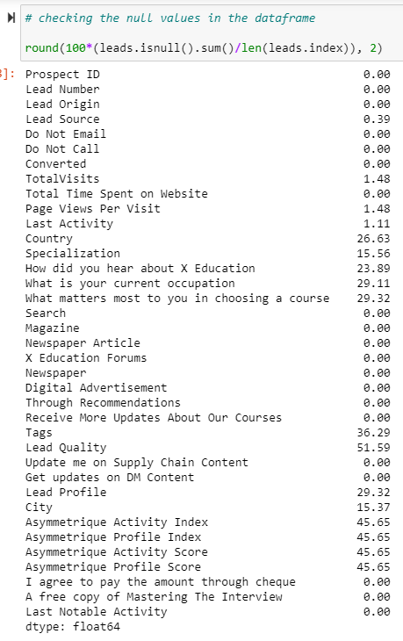
Data Cleaning and Analysis:
We reviewed and cleaned the data for the analysis. To gain a more refined visualization, it is important to clean the data to remove any unnecessary data sets.
We replaced the 'select' option with the null value since it did not give us much information.
We dropped the variables with a null value greater than 40%, and for the remaining null values we made changes in accordance with the data.
We checked if there is any duplicate values in the data frame and also dropped the columns which are not that much important for the analysis.

Slide 5
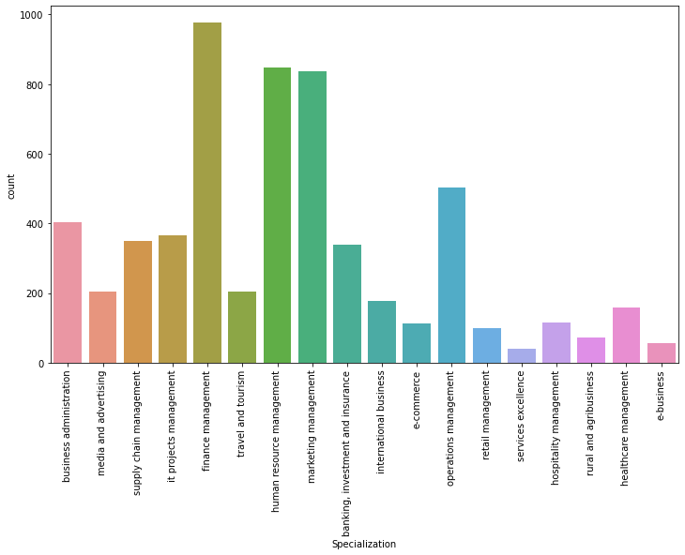
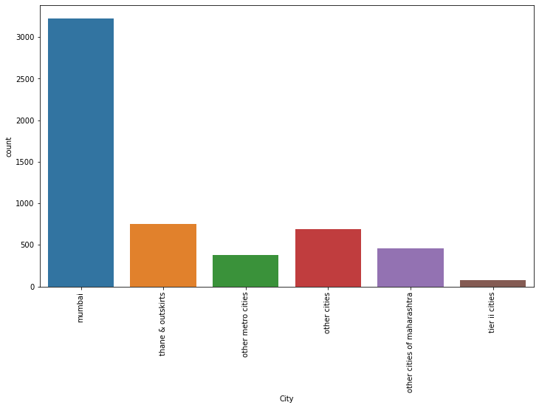
Exploratory Data Analysis (EDA):
Categorical Analysis:
‘Specialization’ column
We can see that the whole management field has converted the most. Whereas, ‘services excellence’, ‘e-business’, ‘agribusiness and rural’ has the lowest conversion rate.
‘City’ column
‘Mumbai’ is the highest in terms of conversion rate, whereas, ‘Tier 2 cities’ have the minimum conversion rate followed by ‘other metro cities’.

Slide 6
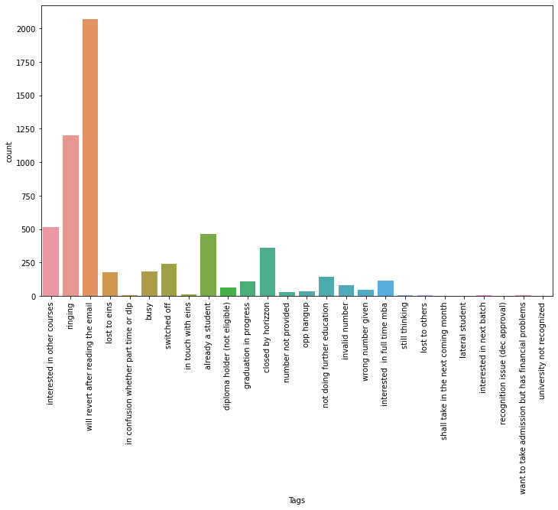
Exploratory Data Analysis (EDA):
‘Tags’ column
Here we can observe that ‘Will revert after reading the mail’ has converted the most, followed by ‘ringing’.
This column contains more null values so after analyzing we dropped the column.

Slide 7
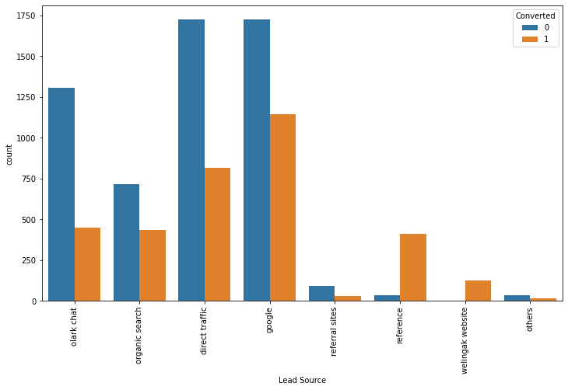
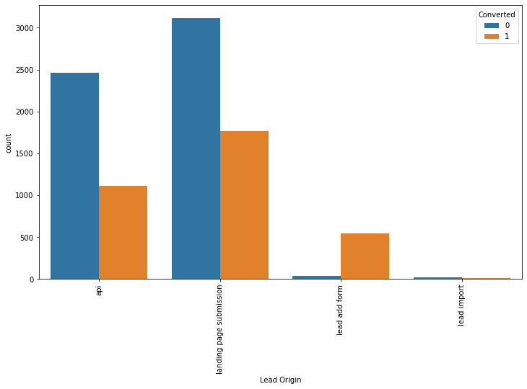
Exploratory Data Analysis (EDA):
Univariate Analysis:
‘Lead Source’ column
we can say that 'direct traffic' and 'Google' convert the maximum number of leads.
The rate of conversion is high for the 'welingak website' and 'reference'.
‘Lead Origin’ column
we can see that 'lead import' count is minimum.
The most conversions came from the 'landing page submission', followed by the 'api'.

Slide 8
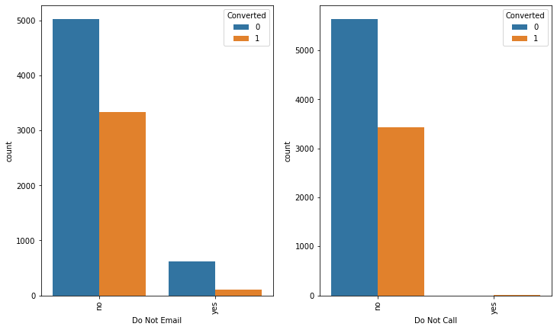
Exploratory Data Analysis (EDA):
‘Do Not Email’ column
The overall count of 'yes' is very low and among them majority of them are not converted.
The leads who choose 'no' is very high compared to the overall count of 'yes'.
‘Do Not Call’ column
There are no leads who has selected 'yes' as a option.
Votes are significantly high for ‘no', with most of the counts not being converted.

Slide 9
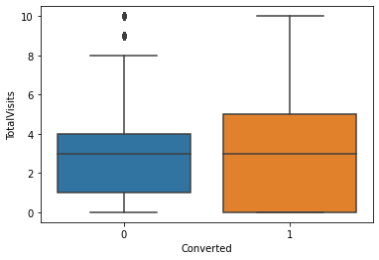
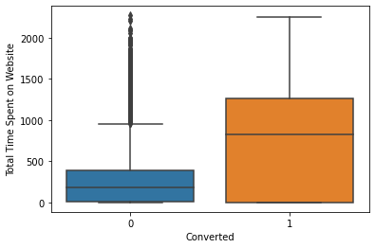
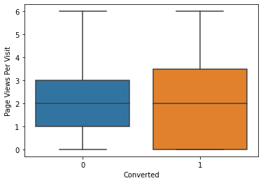
Exploratory Data Analysis (EDA):
‘Total Visits’, ‘Total Time Spent on Website’ and ‘Page Views Per Visit’ column
The conversion rates were high for Total Visits, Total Time Spent on Website and Page Views Per Visit.

Slide 10
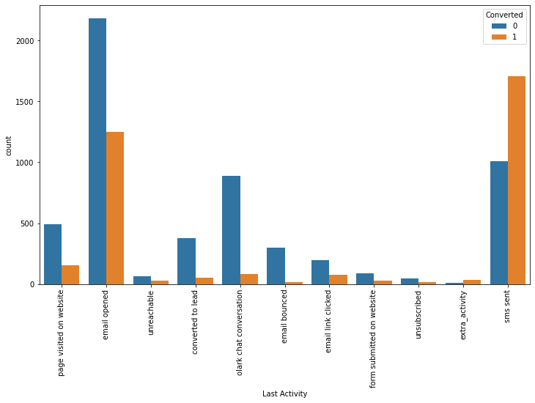
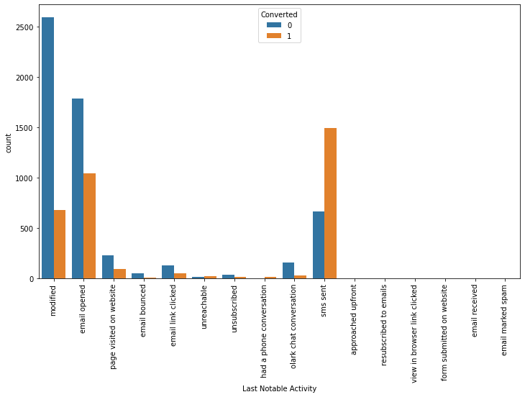
Exploratory Data Analysis (EDA):
‘Last Activity’ column
we can say that Leads are most likely to have opened their email as their last activity.
Highest conversion rate is seen in 'sms sent'.
‘Last Notable Activity’ column
The number of non-converted leads from 'sms sent' is considerably lower as compared to 'e-mail Opened' and 'modified'.
Most converted leads are from the 'sms sent' followed by 'e-mail opened' and then 'modified'.

Slide 11
Dummy Variables:
First we will create a dummy variable for the categorical variables.
Later, after creating a dummies we will merge those variables with the original data frame.
Dropping the unnecessary columns as we have already created dummy variables out of it.
Splitting the data into Test and Train dataset:
We will split the data set into train and test data with a ratio of 70-30%.
After splitting, we will build a model on train data set and later test it on the test data set.
Feature Scaling:
We used the StandardScaler to scale the original numerical variables.
Using the stats model, we created our initial model, which gave us a complete statistical view of each parameter.

Slide 12
Building a logistic Regression model:
The next step is to create X and y train dataset for building a model.
We will use the Logistic Regression function from the Scikit learn for making it suitable with Recursive Feature Elimination (RFE).
The 15 top features were selected based on the RFE.
Based on the VIF values and p-values (VIF < 5 and p-value < 0.05 were kept), the variables that were not significant were manually removed.
Evaluating the model by using different metrics:
Using Final Model, we will create the column ‘Predicated’ with probability cutoff of 0.5.
We derived the Confusion Metrics and calculated the model's overall Accuracy based on the above assumptions.
We could observe the values of the Accuracy = 79.3%, Sensitivity = 67.1%, Specificity = 87.0%.

Slide 13
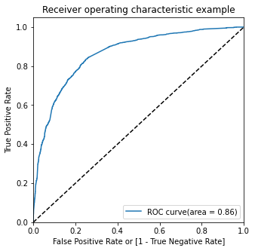
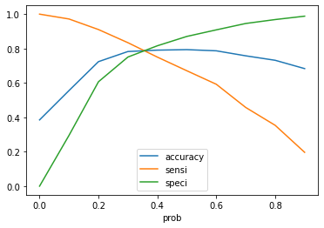
Evaluating the model by using different metrics:
Roc Curve:
We plotted the ROC curve for the features, which showed a good area coverage of 86%, further solidifying our model.
Optimal Cut-off Point:
We plotted the probability graph for Accuracy, Sensitivity, and Specificity for different probabilities and intersection was considered as optimal probability cut-off point.
Based on a cut-off value of 0.37, we use 0.4 as the model estimate.
We could also observe the values of the Accuracy = 79.1%, Sensitivity = 75.0%, Specificity = 81.6%.

Slide 14
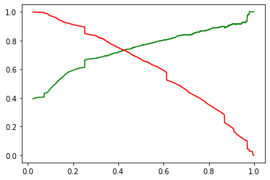
Evaluating the model by using different metrics:
Precision and Recall score:
The graph depicts an optimal cut off of 0.42 based on Precision and Recall.
We found Precision = 71.9% and Recall = 75.0% on the train data frame.
When plotting the ROC curve and the graph based on Precision and Recall metrics, we get almost the same intersection value.
Applying the best model in Test data:
We then applied these learnings to test model and found an Accuracy = 79.1%, Sensitivity = 74.3% and Specificity = 81.8%.

Slide 15
Conclusions:
we have considered the optimal cut-off of 0.4 for calculating the final prediction after checking both Sensitivity-Specificity as well as Precision and Recall metrics.
Accuracy, Sensitivity and Specificity values of test set are around 79.1%, 74.3% and 81.8% which are approximately closer to the respective values calculated using trained set.
The top 3 variables that contribute for lead getting converted in the model are:
Lead Source_olark chat
Last Activity_olark chat conversation
Total Time Spent on Website
This model seems to be very accurate in predicting conversion rates and seems stable when running on a TRAIN SET as well as a TEST SET.
With this model, we should be able to give the CEO confidence in making good decisions.

Slide 16
THANK YOU!!!

